Slide 1
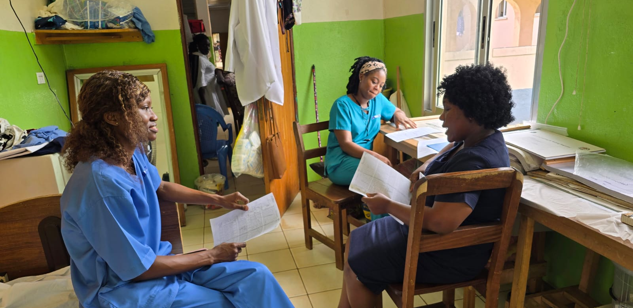


Exploring the impact of a nurse-midwifery led model of clinical mentorship on maternal and neonatal outcomes in rural Liberia
Marshall Sackey¹, Daniel Maweu², Viola Karanja¹, Garmai Forkpah¹, Kimberly Baltzell³, Alden Blair³
1: Partners in Health Liberia; 2: University of Global Health Equity; 3: University of California San Francisco Global Action in Nursing
Background:
Globally, the majority of births are overseen by midwives and nurses, yet they face many challenges especially as less resourced settings. In 2020 the University of California San Francsico Global Action in Nursing (GAIN) partnered with Partners in Health (PIH) Liberia to support three peripheral health centers and one hospital in rural Maryland County. This includes robust data collection and analysis activities.
Intervention:
The intervention began in October 2022 with a midwifery-focused five-day intensive training (Fig1) for providers at all facilities led by local and international clinical experts. An additional facility was added in 2023. Following the trainings, all nurse-midwives at participating facilities have received ongoing longitudinal mentorship (Fig2) by a local expert midwife.
Methods:
Data includes all individual patient-level variables captured in the standardized Liberian Maternity Registers from 2020 until 2023. Data was initially summarized with descriptive statistics followed by Fishers tests to explore occurrences for given complications and outcomes. Discussions with providers explored drivers of associated changes rooted in local understandings.
Figure 2: Mentorship Session
Discussion:
The accurate recording of birth-related care and outcomes are necessary to improve outcomes and allocate resources. As with other GAIN sites, increases in complication reporting did not likewise correspond to increases in maternal mortality. Providers noted that the demands of patient care especially in peripheral facilities could at times affect the effectiveness of record keeping. The low rates of maternal mortality are promising, but show gaps in maternal registers as reporting mechanisms as they only capture the first 24 hours.
Further research is ongoing into patient partographs to assess changes in quality of care.
Results:
Data included a total of 7991 patient records (22.6% pre-intervention, 77.4% post-intervention).
Birth rates ranged from 16/month at the smallest facility to 87/month at the participating hospital.
There were only 16 maternal deaths reported during the study period.
Providers were less likely to record complications that occurred at peripheral health facilities (0.5% to 0.9%) than they were at the referral hospital (14.8%, p<0.001).
The reporting of complications related to maternal risk factors such as hypertension and malpresentation increased (p<0.001 for both) post-intervention.
The reporting of complications associated with birth itself such as post-partum hemorrhage decreased (p=0.05) post-intervention.
Figure 1: Short-course training with participating nurse midwives

