Slide 1




Assessing the Prevalence of Maternal Mental Health Disorders Between Six Weeks and Six Months Postpartum—A Scoping Review
Evelyn Bigini,^{1*} Siri Dalsmo Berge,² Miranda Rouse,¹ Frode Fadnes Jacobsen,³ Ashley Mitchell,¹ Alden Blair¹
¹Global Action In Nursing (GAIN), University of California, San Francisco
GAIN PI: Kimberly Baltzell, RN, PhD, MS
²NORCE Research AS
³Centre for Care Research at Western Norway University of Applied Sciences
*Contact: evelyn.bigini@ucsf.edu
Notes:
Good afternoon. My name is Evelyn Bigini. I am a Registered Nurse and PhD in Nursing Student at the University of California, San Francisco with a group called Global Action in Nursing (or GAIN). We are working on a publication of these results.

Slide 2



Disclosures and Acknowledgements
Why this review: Our partners
Use of ‘maternal* mental health’
Photo from video via www.pih.org
Photo from video via www.pih.org
Notes:
Our purpose for completing this review is to inform our team’s perinatal mental health work with our partners at Partners In Health (PIH) and GAIA Global Health. We are fortunate to learn and work with you.
We want to recognize that not all birthing people identify with the terms “mother” or “maternal.” For consistency, we are using “maternal mental health” for this review, though we recognize and support all birthing people and families and aim to be inclusive with this phrase.

Slide 3
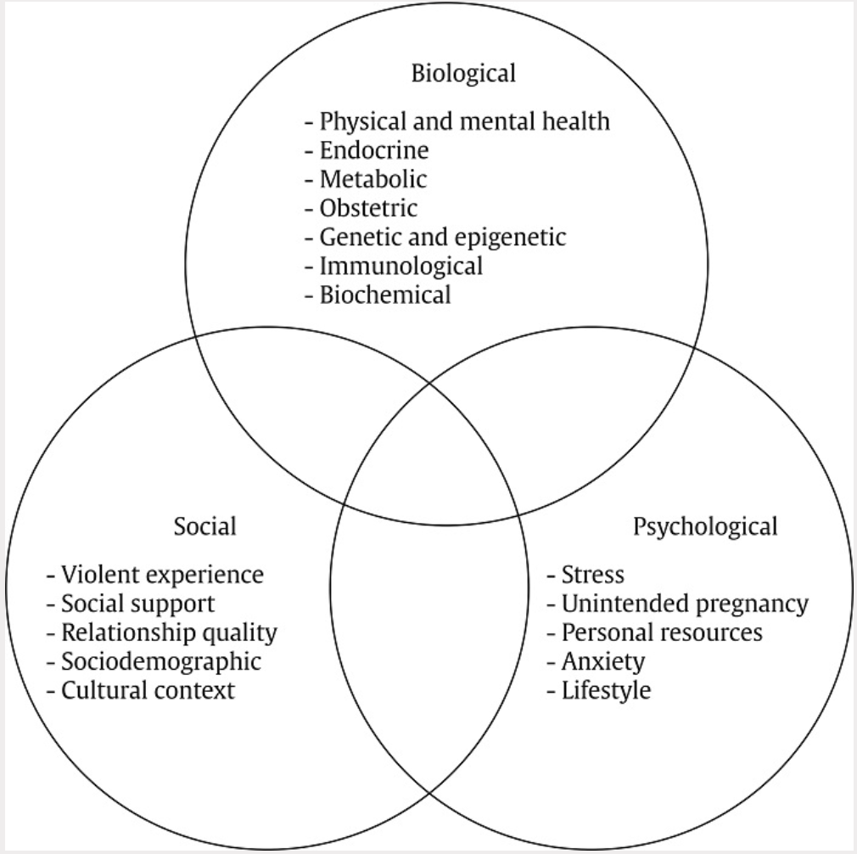
Background
Mental health: critical in the three years following birth
17% global prevalence rate of postpartum depression (PPD)
Lack of research reported from low- and middle-income countries (LMICs) and beyond 6-12 weeks postpartum
Conceptual framework from Žutić, 2023
Notes:
Now, what do we know already? We know that mental health is important globally and across the lifespan.^{1,2} We also know that mental health is critical in the first three years following birth for the mental health of birthing people, infants, families, and societies at large, and poor outcomes extend up to this time period^{1,3,4}
Third, we know mental health disorders are common postpartum: the one most frequently discussed, postpartum depression, has a reported prevalence rate of 17% based on a recent meta-analysis.⁹ Postpartum mental health disorders are also primary causes of morbidity^{5–7} and mortality⁸ for birthing people.

Slide 4
Background
Mental health: critical in the three years following birth
17% global prevalence rate of postpartum depression (PPD)
Lack of research reported from low- and middle-income countries (LMICs) and beyond 6-12 weeks postpartum
Conceptual framework from Žutić, 2023
Notes:
But why do poor mental health outcomes happen postpartum? There is a complex interaction of contextual, overlapping, multi-level factors influencing an individual’s risks for perinatal mental health disorders.^{9,14-17} And these factors vary across contexts and are not neatly tied up in a bow by the time of people’s last postpartum visit around 6 weeks postpartum^{3,7,10,11,18}
However, we find that there is a comparative lack of research reporting on the topic from low- and middle-income countries^{9,10} and beyond 6-12 weeks postpartum^{9,11–13}

Slide 5
Scoping Review Methods
Aim of scoping review | Search strategy (PubMed, Embase, CINHAL)
Document the global incidence/prevalence of PPD and other mental health disorders 6 weeks to 6 months postpartum Evidence from 2019-2024 | Title/abstract: (("postpartum depression") OR (("postpartum" OR "postnatal" OR "post-partum" OR "post-natal") AND depress*)) AND ("incidence" OR "prevalence" OR diagnos* OR treat* OR screen*)) Database vocabularies: MeSH and Emtree terms Filters: Past 5 years, clinical queries, English
Notes:
The aim of this scoping review was to document the global incidence and prevalence of postpartum depression and other mental health disorders occurring between 6 weeks and 6 months postpartum. We wanted to understand the current state of the literature, so we limited our results to the last five years from when we conducted the search of 3 databases in July 2024.

Slide 6
Scoping Review Methods
Aim of scoping review | Search strategy (PubMed, Embase, CINHAL)
Document the global incidence/prevalence of PPD and other mental health disorders 6 weeks to 6 months postpartum Evidence from 2019-2024 | Title/abstract: (("postpartum depression") OR (("postpartum" OR "postnatal" OR "post-partum" OR "post-natal") AND depress*)) AND ("incidence" OR "prevalence" OR diagnos* OR treat* OR screen*)) Database vocabularies: MeSH and Emtree terms Filters: Past 5 years, clinical queries, English
Notes:
We worked with a university medical librarian to develop the clinically-focused search strategy, which included title/abstract terms as well as database vocabularies

Slide 7
Methods
Inclusion criteria | Exclusion criteria
Population: Birthing people who are between 6 weeks and 6 months postpartum (inclusive) Study type: Cohort, cross-sectional, case-control studies, intervention studies with control group Outcome: Incidence and/or prevalence for postpartum mental health diagnoses or symptoms measured with a validated tool 6 weeks to 6 months postpartum (inclusive) Characteristics: Full-text in English available | Population: Entire sample hypothesized to have higher rates of postpartum mental health conditions (e.g., all had previously diagnosed mental health conditions) Study type: Intervention studies with no control group, protocols, qualitative studies, case studies Outcome: Measurement of only mental health symptom severity (not prevalence/incidence) Characteristics: No full-text in English available
Notes:
This review included studies with birthing people between 6 weeks and 6 months postpartum, excluding studies that only included samples of people hypothesized to have higher rates of mental health conditions, as this could inflate the overall incidence/prevalence rate reported in our results

Slide 8
Methods
Inclusion criteria | Exclusion criteria
Population: Birthing people who are between 6 weeks and 6 months postpartum (inclusive) Study type: Cohort, cross-sectional, case-control studies, intervention studies with control group Outcome: Incidence and/or prevalence for postpartum mental health diagnoses or symptoms measured with a validated tool 6 weeks to 6 months postpartum (inclusive) Characteristics: Full-text in English available | Population: Entire sample hypothesized to have higher rates of postpartum mental health conditions (e.g., all had previously diagnosed mental health conditions) Study type: Intervention studies with no control group, protocols, qualitative studies, case studies Outcome: Measurement of only mental health symptom severity (not prevalence/incidence) Characteristics: No full-text in English available
Notes:
We included cohort, cross-sectional, case-control, and intervention studies with control groups, as we extracted data from the control group for these studies

Slide 9
Methods
Inclusion criteria | Exclusion criteria
Population: Birthing people who are between 6 weeks and 6 months postpartum (inclusive) Study type: Cohort, cross-sectional, case-control studies, intervention studies with control group Outcome: Incidence and/or prevalence for postpartum mental health diagnoses or symptoms measured with a validated tool 6 weeks to 6 months postpartum (inclusive) Characteristics: Full-text in English available | Population: Entire sample hypothesized to have higher rates of postpartum mental health conditions (e.g., all had previously diagnosed mental health conditions) Study type: Intervention studies with no control group, protocols, qualitative studies, case studies Outcome: Measurement of only mental health symptom severity (not prevalence/incidence) Characteristics: No full-text in English available
Notes:
We were looking for the incidence and/or prevalence based on validated scales or clinical diagnoses

Slide 10
Methods
Inclusion criteria | Exclusion criteria
Population: Birthing people who are between 6 weeks and 6 months postpartum (inclusive) Study type: Cohort, cross-sectional, case-control studies, intervention studies with control group Outcome: Incidence and/or prevalence for postpartum mental health diagnoses or symptoms measured with a validated tool 6 weeks to 6 months postpartum (inclusive) Characteristics: Full-text in English available | Population: Entire sample hypothesized to have higher rates of postpartum mental health conditions (e.g., all had previously diagnosed mental health conditions) Study type: Intervention studies with no control group, protocols, qualitative studies, case studies Outcome: Measurement of only mental health symptom severity (not prevalence/incidence) Characteristics: No full-text in English available
Notes:
And the studies had to have full-text in English available

Slide 11
Results
Studies from databases/registers (n = 1635)
PubMed (n = 1007)
Embase (n = 564)
CINAHL (n = 64)
Citation searching (n = 78)
Identification
References removed (n = 107)
Duplicates identified by Covidence (n = 107)
Studies screened (n = 1606)
Studies excluded (n = 1378)
Screening
Studies assessed for eligibility (n = 228)
Studies excluded (n = 148)
Wrong measures (n = 19)
Article retracted (n = 3)
Not 6wk-6mo specific (n = 78)
Full-text not English (n = 1)
Full-text not available (n = 4)
Wrong inclusion/exclusion criteria (n = 37)
Low quality (n = 2)
Studies included in review (n = 80)
Included
Notes:
From our search, we identified 1,635 articles, including 78 through snowball sampling citations from review articles to reduce the risk of missing studies in our search

Slide 12
Results
Studies from databases/registers (n = 1635)
PubMed (n = 1007)
Embase (n = 564)
CINAHL (n = 64)
Citation searching (n = 78)
Identification
References removed (n = 107)
Duplicates identified by Covidence (n = 107)
Studies screened (n = 1606)
Studies excluded (n = 1378)
Screening
Studies assessed for eligibility (n = 228)
Studies excluded (n = 148)
Wrong measures (n = 19)
Article retracted (n = 3)
Not 6wk-6mo specific (n = 78)
Full-text not English (n = 1)
Full-text not available (n = 4)
Wrong inclusion/exclusion criteria (n = 37)
Low quality (n = 2)
Studies included in review (n = 80)
Included
Notes:
Two reviewers screened 1,606 of these studies’ title/abstracts, with a third reviewer resolving conflicts

Slide 13
Results
Studies from databases/registers (n = 1635)
PubMed (n = 1007)
Embase (n = 564)
CINAHL (n = 64)
Citation searching (n = 78)
Identification
References removed (n = 107)
Duplicates identified by Covidence (n = 107)
Studies screened (n = 1606)
Studies excluded (n = 1378)
Screening
Studies assessed for eligibility (n = 228)
Studies excluded (n = 148)
Wrong measures (n = 19)
Article retracted (n = 3)
Not 6wk-6mo specific (n = 78)
Full-text not English (n = 1)
Full-text not available (n = 4)
Wrong inclusion/exclusion criteria (n = 37)
Low quality (n = 2)
Studies included in review (n = 80)
Included
Notes:
Two reviewers then screened the 228 of these studies’ full-text for eligibility, again with a third reviewer resolving conflicts, most often because they were not 6 weeks to 6 months specific

Slide 14
Results
Studies from databases/registers (n = 1635)
PubMed (n = 1007)
Embase (n = 564)
CINAHL (n = 64)
Citation searching (n = 78)
Identification
References removed (n = 107)
Duplicates identified by Covidence (n = 107)
Studies screened (n = 1606)
Studies excluded (n = 1378)
Screening
Studies assessed for eligibility (n = 228)
Studies excluded (n = 148)
Wrong measures (n = 19)
Article retracted (n = 3)
Not 6wk-6mo specific (n = 78)
Full-text not English (n = 1)
Full-text not available (n = 4)
Wrong inclusion/exclusion criteria (n = 37)
Low quality (n = 2)
Studies included in review (n = 80)
Included
Notes:
Overall, we included 80 studies that met our eligibility criteria, and one reviewer extracted data from each study

Slide 15
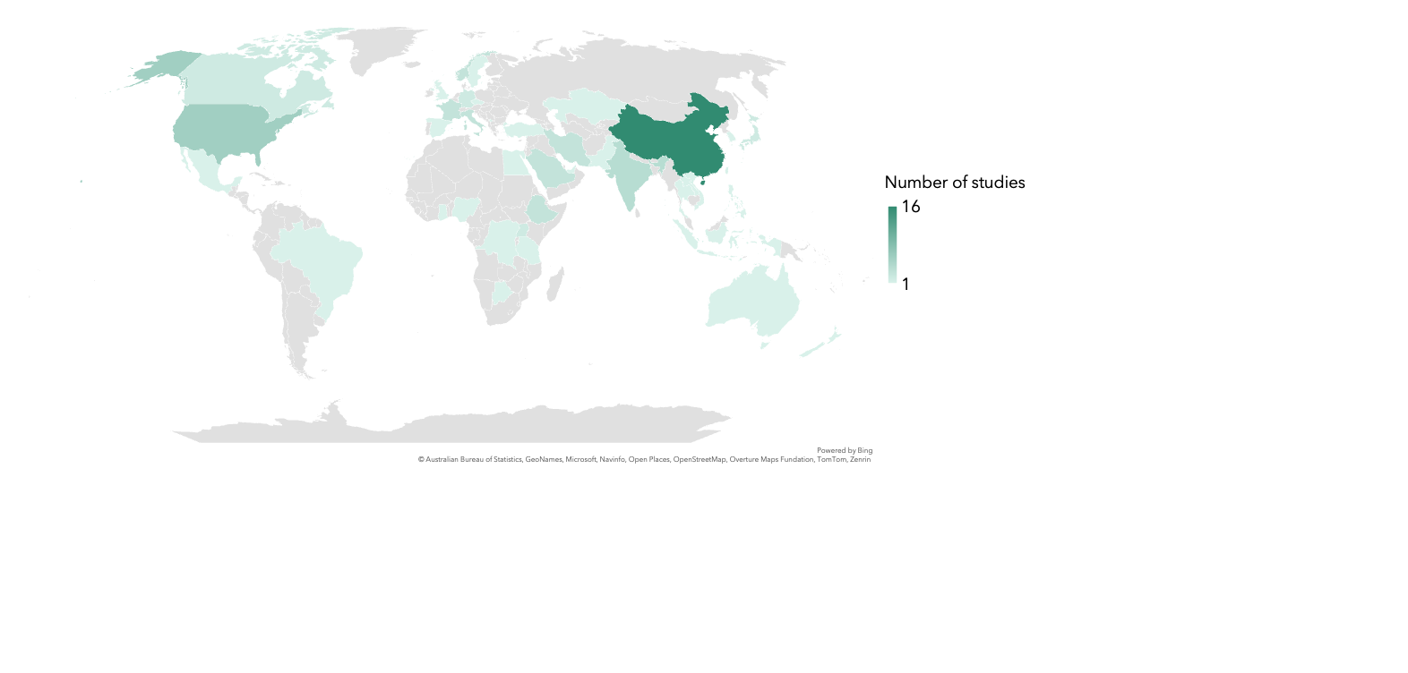
Results
Study countries
Notes:
There were 40 countries represented within the 80 studies, with more than 75% of the studies coming from high-income and upper middle countries
As indicated by the map shading, the country with the largest number of studies was China, with 16, followed by the U.S. (6) and India (4).

Slide 16
Results
Depression and: anxiety (n=2), post-traumatic stress disorder (PTSD) (n=1), anxiety and PTSD (n=1), postpartum adjustment disorder (n=1)
Notes:
In terms of mental health conditions examined, 73 studies measured postpartum depression only. Five studies measured depression and other conditions, including anxiety, PTSD, both anxiety and PTSD, and postpartum adjustment disorder.

Slide 17
Results
TOTAL STUDIES (n=80)
Single time period (n=63)
Multiple time periods (n=17)
Including 6-8 weeks (n=8)
Only 6-8 weeks (n=42)
Up to: 9-12 weeks (n=5) 3 months (n=2) 14-25 weeks (n=5) 6 months (n=9)
Not including 6-8 weeks (n=9)
TOTAL MEASUREMENTS (n=142)
Notes:
Among the 80 studies, over ¾ of them measured mental health disorder prevalence/incidence at one time, and among those studies, 2/3 measured only within 6-8 weeks
For studies measuring multiple time periods, it was about even which studies included a 6-8 week measurement and those that focused on the 9 weeks to 6 months postpartum.

Slide 18
Results
TOTAL STUDIES (n=80)
Single time period (n=63)
Multiple time periods (n=17)
Including 6-8 weeks (n=8)
Only 6-8 weeks (n=42)
Up to: 9-12 weeks (n=5) 3 months (n=2) 14-25 weeks (n=5) 6 months (n=9)
Not including 6-8 weeks (n=9)
TOTAL MEASUREMENTS (n=142)
Notes:
We used a total of 142 measurements to calculate the remaining results presented today, 127 of which were for postpartum depression. There are more measurements than studies because 1) we can see that some studies included more than one measurement of the same or disaggregated sample, 2) some studies did not report the total prevalence rate but only for subgroups, e.g., by contraception group, and 3) some studies reported more than one incidence/prevalence rate through the use of multiple cut-off scores, all of which we used

Slide 19
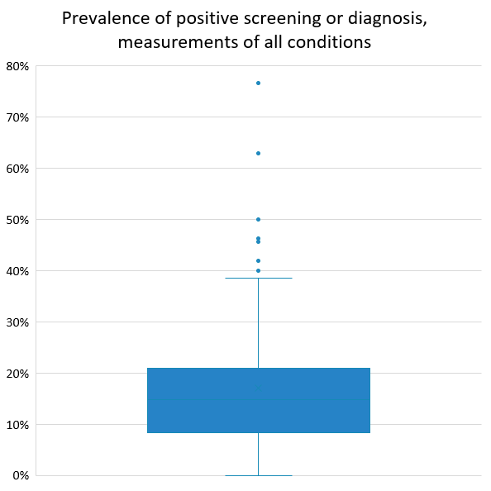
Results
Max: 76.6%
Median: 14.9%
IQR: 12.4%
Min: 0%
Notes:
The median positive prevalence screening rate for all conditions was 14.9%. We can interpret this as, overall, approximately 1 in 7 birthing people screened positive or were diagnosed with a mental health disorder between 6 weeks to 6 months postpartum. Think about if people in this room, for example, were postpartum people. How many of us would receive a diagnosis or positive screening?

Slide 20
Results
Max: 76.6%
Median: 14.9%
IQR: 12.4%
Min: 0%
Notes:
There were some outliers in our study. The maximum prevalence rate was 76.6%, from a control group of 64 people from a district-wide study of (smartphone owning) women from (Java) Indonesia. Tool and cut-off score: EPDS, 10

Slide 21
Results
Max: 76.6%
Median: 14.9%
IQR: 12.4%
Min: 0%
Notes:
We found 4 0% prevalence rates found in this analysis. They were from control groups in two studies—one in Botswana and one in Tanzania. The sample sizes were all over 100. One measurement was at 3 months and the others were at 6 months postpartum.
We wouldn’t expect prevalence rates of 76% and 0%, exposing implications I’ll talk about in the discussion
Tools and cut-off scores: 1) EPDS of 13 or thoughts of self-harm, 2 and 3) HTQ-16 (Harvard Trauma Questionnaire) 2.5 (recommended cut-off), 4) PHQ-9 of 10 (at least moderate depression)

Slide 22
Results
Max: 76.6%
Median for PPD measurements: 16.3%
IQR: 12.6%
Same Min and Max
Median: 14.9%
IQR: 12.4%
Min: 0%
Notes:
The median incidence/prevalence rate of the PPD-specific measurements was 16.3%, a little higher, so overall 1 in 6 birthing people screened positive or were diagnosed with postpartum depression.

Slide 23
PPD Results
EPDS cut-off scores not standardized → challenges interpreting across studies
Statistics:
Median: 11
Min: 9
Max: 14
Criteria:
Self-harm or cut-off score
Range of scores
Inclusive/exclusive
Score not reported
Notes:
Over 80% of measurements for PPD used the Edinburgh Postnatal Depression Scale. Looking into that tool, we used inclusive scores to calculate the median cut-off, which was 11--meaning 11 or higher indicated positive PPD symptom screening.

Slide 24
PPD Results
EPDS cut-off scores not standardized → challenges interpreting across studies
Statistics:
Median: 11
Min: 9
Max: 14
Criteria:
Self-harm or cut-off score
Range of scores
Inclusive/exclusive
Score not reported
Notes:
However, there was a lack of standardized cut-off scores for the EPDS used, making interpretation challenging—some participants would be considered to score positive in one study but not another, for example. The cut-off scores ranged from 9 to 14—why was that so??, and criteria differed. One study considered a positive screen as reaching the cut-off score or indicating thoughts of self-harm, one study reported a range of scores as meeting positive screening, and one study did not report the cut-off score they used. Moreover, the way that the cut-off scores were reported varied between studies whether they were inclusive or exclusive of the score they reported.
The studies cited reasoning for using their cut-off scores, but we need more information about why the validated cut-off scores differ and what it means for measuring maternal mental health—are we measuring the same thing across studies with different contexts?

Slide 25
Discussion
Emphasis on 6-8 weeks postpartum
Limited Low-Income Country (LIC) representation
Limitations:
1. PPD-dominated search/results
2. Unweighted calculations
3. Measurements of same samples
Majority focus on PPD alone
Outliers and lack of standardized cut-off score for EPDS
16.3% (this study's PPD prevalence) vs 17% (global PPD prevalence)
Notes:
Overall, we found little LIC representation among studies, which had a majority focus on PPD alone, and an emphasis on 6-8 weeks postpartum. There were also outlier measurements and a lack of standardization for measuring PPD with the EPDS, requiring further investigation into how responsive measurement tools and cut-off scores are to local populations.
However, this study still found an overall prevalence rate of PPD similar to that of a recent meta-analysis of 565 studies (1,236,365 women) that did not examine 6 weeks-6 months postpartum specifically, demonstrating that PP mental health disorders persist in this period
The limitations of this study are that the search and results were PPD-dominated, we did not calculate the overall prevalence/incidence rate weighted by sample size, and given that we used multiple measurements, some of the same samples were included multiple times in our calculations

Slide 26

Implications
Need for more comparable incidence and prevalence data:
From LMICs, particularly LICs
Focusing beyond 6-8 weeks postpartum
Including conditions other than PPD
Analyzed in systematic reviews, including meta-analyses
Explored with qualitative data
Clinical and policy foci beyond 6 weeks postpartum
Notes:
From this study, we see that we need more comparable incidence and prevalence data 1) from LMICs, particularly LICs, 2) focusing beyond 6-8 weeks postpartum, 3) including conditions other than PPD, 4) analyzed in systematic reviews, including meta-analyses, and 5) explored with qualitative data to understand patients’ mental health understandings and experiences
We see that PPD and other mental health conditions are prevalent between 6 weeks and 6 months postpartum, and thus we need clinical and policy solutions to focus on preventing, detecting, and treating such conditions

Slide 27
References
1. Patel V, Saxena S, Lund C, et al. The Lancet Commission on global mental health and sustainable development. The Lancet. 2018;392(10157):1553-1598. doi:10.1016/S0140-6736(18)31612-X
2. United Nations. Constitution of the World Health Organization.; 1948.
3. Nweke M, Ukwuoma M, Adiuku-Brown AC, Okemuo AJ, Ugwu PI, Nseka E. Burden of postpartum depression in sub-Saharan Africa: An updated systematic review. South Afr J Sci. 2024;120(1/2). doi:10.17159/sajs.2024/14197
4. Putnick DL, Sundaram R, Bell EM, et al. Trajectories of Maternal Postpartum Depressive Symptoms. Pediatrics. 2020;146(5):e20200857. doi:10.1542/peds.2020-0857
5. Fitzgerald L, McNab S, Njau P, et al. Beyond survival: Prioritizing the unmet mental health needs of pregnant and postpartum women and their caregivers. Chibanda D, ed. PLOS Glob Public Health. 2024;4(2):e0002782. doi:10.1371/journal.pgph.0002782
6. Howard LM, Molyneaux E, Dennis CL, Rochat T, Stein A, Milgrom J. Non-psychotic mental disorders in the perinatal period. The Lancet. 2014;384(9956):1775-1788. doi:10.1016/S0140-6736(14)61276-9
7. World Health Organization. WHO Recommendations on Maternal and Newborn Care for a Positive Postnatal Experience. 1st ed. World Health Organization; 2022. https://iris.who.int/bitstream/handle/10665/352658/9789240045989-eng.pdf?sequence=1
8. Amiri S, Behnezhad S. The global prevalence of postpartum suicidal ideation, suicide attempts, and suicide mortality: A systematic review and meta-analysis. Int J Ment Health. 2021;50(4):311-336. doi:10.1080/00207411.2021.1959814
9. Wang Z, Liu J, Shuai H, et al. Mapping global prevalence of depression among postpartum women. Transl Psychiatry. 2021;11(1):543. doi:10.1038/s41398-021-01663-6
10. McNab SE, Dryer SL, Fitzgerald L, et al. The silent burden: a landscape analysis of common perinatal mental disorders in low- and middle-income countries. BMC Pregnancy Childbirth. 2022;22(1):342. doi:10.1186/s12884-022-04589-z
11. American College of Obstetricians and Gynecologists. ACOG committee opinion no. 736: Optimizing postpartum care. Obstet Gynecol. 2018;131(5):e140-e150. doi:10.1097/AOG.0000000000002633
12. Matsuoka H, Iwami S, Maeda M, Suizu A, Fujii T. Edinburgh Postnatal Depression Scale scores at 2‐week post‐partum may reflect those at 4‐week post‐partum: A single‐center retrospective observational study. J Obstet Gynaecol Res. 2021;47(2):508-514. doi:10.1111/jog.14540
13. Suharwardy S, Ramachandran M, Leonard SA, et al. Feasibility and impact of a mental health chatbot on postpartum mental health: a randomized controlled trial. AJOG Glob Rep. 2023;3(3):100165. doi:10.1016/j.xagr.2023.100165
14. Abouhala S, Yakubu RA, Snape L, et al. The Role of Health Systems in Black Maternal Mental Health Care Delivery: a Socio-Ecological Framework. Curr Treat Options Psych. 2023;10(4):383-403. doi:10.1007/s40501-023-00306-5
15. Nweke M, Ukwuoma M, Adiuku-Brown AC, Ugwu P, Nseka E. Characterization and stratification of the correlates of postpartum depression in sub-Saharan Africa: A systematic review with meta-analysis. Womens Health (Lond Engl). 2022;18:17455057221118773. doi:10.1177/17455057221118773
16. Wohrer F, Ngo H, DiDomenico J, Ma X, Roberts MH, Bakhireva LN. Potentially modifiable risk and protective factors affecting mental and emotional wellness in pregnancy. Front Hum Neurosci. 2024;18. doi:10.3389/fnhum.2024.1323297
17. Žutić M. Biopsychosocial Models of Peripartum Depression: A Narrative Review. Clínica y Salud. 2023;34(2):91-99
18. Howard LM, Khalifeh H. Perinatal mental health: a review of progress and challenges. World Psychiatry. 2020;19(3):313-327. doi:10.1002/wps.20769

Slide 28
Thank you!
Evelyn Bigini,^{1*} Siri Dalsmo Berge,² Miranda Rouse,¹ Frode Fadnes Jacobsen,³ Ashley Mitchell,¹ Alden Blair¹
¹Global Action In Nursing (GAIN), University of California, San Francisco
GAIN PI: Kimberly Baltzell, RN, PhD, MS
²NORCE Research AS
³Centre for Care Research at Western Norway University of Applied Sciences
*Contact: evelyn.bigini@ucsf.edu

Slide 29
Results
Notes:
Regarding study types, half of the studies were cohort studies, followed by cross-sectional (25), randomized/experimental (13), case-control (1), and instrument validation (1)
1. If want to speak more about theoretical model, can drop this slide and verbally say- cohort/cross-sectional

Slide 30

Reported global prevalence rate of postpartum depression (PPD): 17%
Picture credit: itoldya test1 – GetArchive
Copyright: CC0 1.0 Universal

