Slide 1





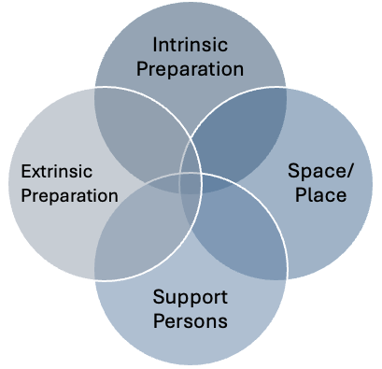



The Collaborative Adaptation of the “Preparation for Labor and Birth (P-LAB)” Instrument for Community-Based Birth
Ashley Mitchell (ashley.mitchell@ucsf.edu), Nikia Grayson, Patience Afulani, Alden Hooper Blair, Kimberly Baltzell, Alexis Dunn Amore
Step 1: Expert Review of P-LAB’s relevance and completeness.
Step 2: Community Review of adaptation for comprehension, ease of response, and perceived relation to prenatal confidence.
Strengths & Limitations
Community-based birth supported by nurses and midwives is increasing in the United States with potential to reduce racial birth disparities.
Prenatal confidence is related to improved outcomes (i.e. reduced unplanned cesarean deliveries) and experiences, though measures are limited.
We adapted the previously validated Preparation for Labor and Birth (P-LAB) instrument for community-based births, centering the perspectives of Black populations.
Participatory adaptation approach
Adapted instrument is promising for use as one of many conversational tools to assess and bolster prenatal confidence
Small, relatively homogenous samples
Potential for participant burden with scale length
Written Assessments (N=5)
Group Review Session (N=3)
Cognitive Interview Participants (N=10)
Pretest Participants
(N=5)
Averaged item scores and comments informed the group session, which yielded an adapted conceptual model and instrument.
Responses were analyzed via the Framework Method and the adapted instrument was pretested.
The conceptualization of confidence to achieve physiologic childbirth used in the original instrument was adapted to align with community- and midwifery models of care.
The final product, the Preparation for Community-based Labor and Birth (P-CLAB), is a 23-item, Likert-response* survey. Three prompt examples related to “Space/Place” are shown below:
Conclusions
The P-CLAB is being administered at multiple, Black-led birth centers in the U.S. and psychometric analysis is planned toward further validation. The P-CLAB has the potential to inform interventions which improve childbirth experiences among populations at greater risk for mistreatment, discrimination, and poor outcomes across the perinatal period.
1. I feel comfortable with planning to birth in a community setting (i.e. not at a hospital)
16. My birth will take place in a calm, supportive environment
17. Given my racial identity, I feel comfortable with the providers with whom I receive prenatal care
*answer options: a) Strongly Disagree, b) Disagree, c) Neutral, d) Agree e) Strongly Agree
Designed and conducted in close partnership with leadership at CHOICES Memphis Center for Reproductive Health; approved by UCSF Human Research Protection Program (HRPP) (23-40122); funded by the University of California, San Francisco National Center of Excellence in Women’s Health.

