Slide 1
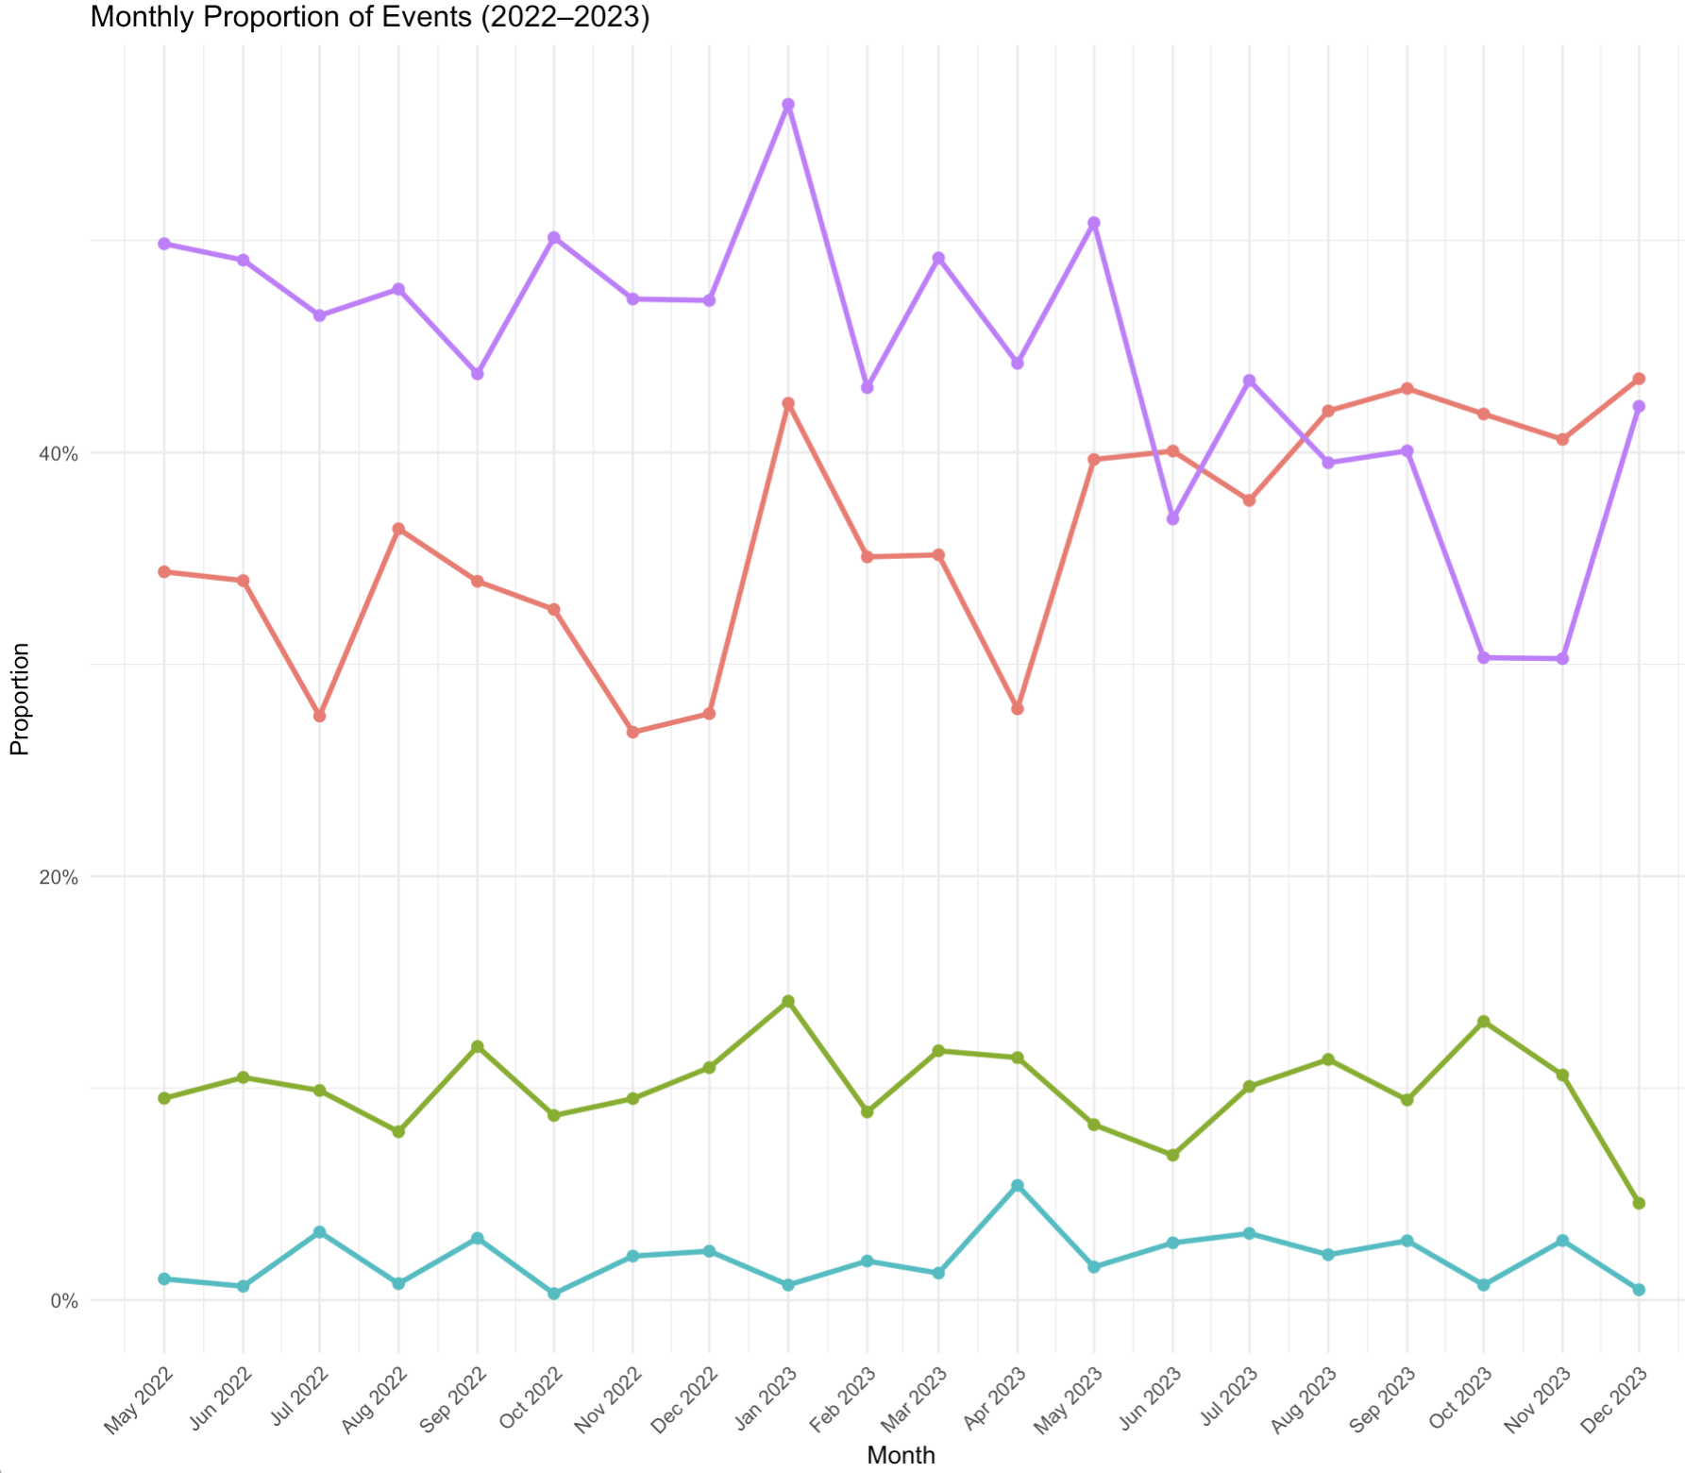




Exploring the impact of longitudinal clinical mentorship for nurses and midwives on maternal and neonatal outcomes in rural Sierra Leone
Alden Hooper Blair, Patricia Efe Azikiwe, Gladys Jepkogei, Ashley Mitchell, Daniel Maweu, Kimberly Baltzell
Background:
Table 1:
Results:
Conclusion:
Majority of maternal and neonatal care globally is provided by nurses and midwives.
Challenges to optimal patient outcomes staffing shortages, constrained supplies, and limited clinical mentorship.
In Sierra Leone, these challenges are omnipresent and maternal and neonatal health outcomes are well below the Sustainable Development Goal targets.
In September 2022, an intervention of intensive, short-course training and longitudinal bedside mentorship for nurse-midwives started in Kono district.
Distribution of select patient outcomes over time at participating facilities
Total of 8,137 discrete patient encounters were included from four health facilities, including 6161 births.
Of the 8137 patient encounters, 1125 (13.8%) were from the pre-intervention period and 6912 (86.2%) post-intervention.
Patients were seen at four health facilities, ranging from 12 encounters per month at the smallest facility to 378 per month at the district hospital.
Post-intervention, providers were significantly more likely to identify birth complications.
Significant decrease in the reporting of uncomplicated spontaneous vaginal deliveries (p=0.014).
Significant decrease in maternal death (p=0.05).
No significant increase in referral to advanced care (p=0.27).
Following the combined training and mentorship intervention, providers were more likely to identify and report complications in patients.
There was no increase in referral rates or reported negative outcomes despite increased reporting of complications.
Recommendations:
Interventions combining education with longitudinal mentorship are a promising solution to improving maternal and neonatal health.
Methods:
Patient-level data were extracted from maternal registers at four participating health facilities from May 2022 to December 2023.
Descriptive statistics summarized patient care, interventions, and outcomes.
Subsequent bivariate and multivariate analyses explored the impact of the intervention on these variables in the presence of confounders.
This study was approved by the UCSF Human Research Protection Program (23-38364) and the Sierra Leone Ethics and Scientific Review Committee. This research was conducted with generous funding from the Wyss Medical Foundation.

