Slide 1
IMPACT OF A LONGITUDINAL MENTORSHIP ON MATERNAL VITAL SIGNS DOCUMENTATION IN BLANTYRE DISTRICT, MALAWI
Nelson Mwale
22 August 2024
GAIA Global Health
University of California San Francisco
Global Action in Nursing

Slide 2
Background
World Health Organization
Safe Childbirth Checklist
(WHO SCC)

Slide 3
Background
LOCATION OF MALAWI ON AFRICA
LOCATION OF BLANTYRE DISTRICT ON MALAWI

Slide 4
Background
Quality of (health) Care (QoC)
Strong maternal & neonatal indicator
Poor in many LIC e.g. Malawi
Contributing factors:
Staffing levels
Equipment
Case loads
Insufficient training
Data
Support

Slide 5
Background
Pause points (PP) assessments
Resources

Slide 6
Background
PP1: ON ADMISSION
Assessment… need referral?
Temperature…. Antibiotics needed?
Blood pressure.. Magnesium sulfate needed?
Antihypertensives needed?
Heart rate for both
PP2: BEFORE PUSHING OR CAESSECTIONAREAN
Temperature
Blood pressure
Heart rate (both)
Supplies
PP3: SOON AFTER BIRTH (WITHIN 1HOUR)
Bleeding?
Vital signs (both)
Referral needed? (mother/baby)
Antibiotics/antihypertensives/magnesium
PP4: BEFORE DISCHARGE
Period after delivery
Breastfeeding
Medication needed?
Follow up
Vital signs (both)

Slide 7
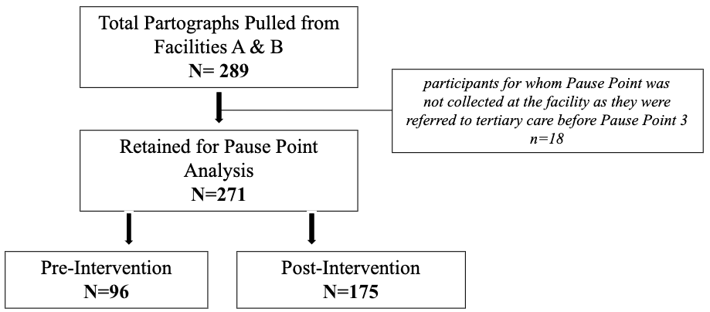
Methods
Sample (2018 -2022)
Type | Retrospective Quantitative Data Collection
Setting | Blantyre, Malawi Two health centres & a tertiary hospital
Approvals | USA: UCSF- Human Rights Protection Program Malawi: National Health Sciences Research Committee
Design | Pre- & post-intervention study

Slide 8
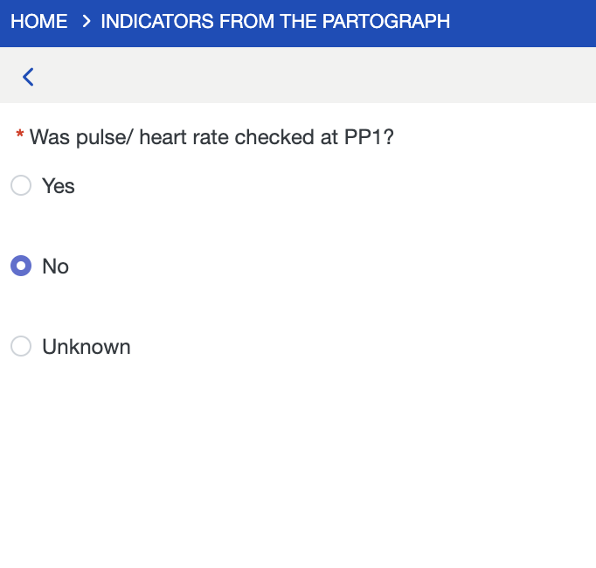
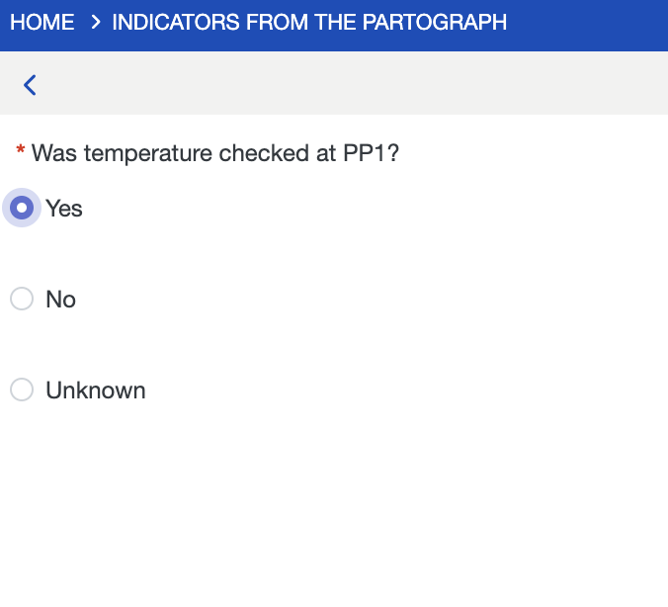
Methods
Data exported from CommCare to Excel
Uploaded to R V4.1.0
Descriptive analysis followed by bivariate analyses
Kruskal Wallis & Fisher’s Exact Test
Differences (documentation & associations)
Multivariate regression (differences & associations)
In all cases, a p-value < 0.05 was considered significant

Slide 9
Results
Table showing Number of Total Key Vital Signs by Pause Point (PP) Pre-Intervention (N=96) and Post-Intervention (N=175)
 | Total (N=271) | Pre-Int (N=96) n (%) | Post-Int (N=175) N (%) | p-value
PP1: Admission
all recorded | 11 (4.1%) | 2 (2.1%) | 9 (5.1%) | 0.017
two recorded | 125 (46.1%) | 34 (35.4%) | 91 (52.0%)
one recorded | 19 (7.01%) | 8 (8.3%) | 11 (6.3%)
none recorded | 116 (42.8%) | 52 (54.2%) | 64 (36.6%)

Slide 10
Results
Table Cont’d | Total (N=271) | Pre-Int (N=96) n (%) | Post-Int (N=175) N (%) | p-value
PP2: Before pushing or Caesarean section
all recorded | 4 (1.5%) | 1 (1.0%) | 3 (1.7%) | 0.546
two recorded | 34 (12.5%) | 10 (10.4%) | 24 (13.7%)
one recorded | 7 (2.6%) | 4 (4.2%) | 3 (1.7%)
none recorded | 226 (83.4%) | 81 (84.4%) | 145 (82.9%)
PP3: Immediate postpartum (within 1 hour)
all recorded | 6 (2.2%) | 3 (3.1%) | 3 (1.7%) | 0.002
two recorded | 97 (35.8%) | 21 (21.9%) | 76 (43.4%)
one recorded | 9 (3.3%) | 3 (3.1%) | 6 (3.4%)
none recorded | 159 (58.7%) | 69 (71.9%) | 90 (51.4%)

Slide 11
Results
*statistically significant difference (p < 0.05)

Slide 12
Results
↑23% documentation in post intervention
Significant improvement at admission & immediate postpartum
>50% recorded heart rate and BP, post-intervention
Both centres
↑documentation at centre B
Less busy
No significant associations with resource availability
(individual device vs related vital sign)
↑ documentation at PP1 even when centres’ resources were only partially stocked

Slide 13
Conclusions
Increased documentation in post intervention
Documentation low in busier facility
Low documentation just before birth (PP2)
Conflicting priorities
No association between resource availability and documentation

Slide 14
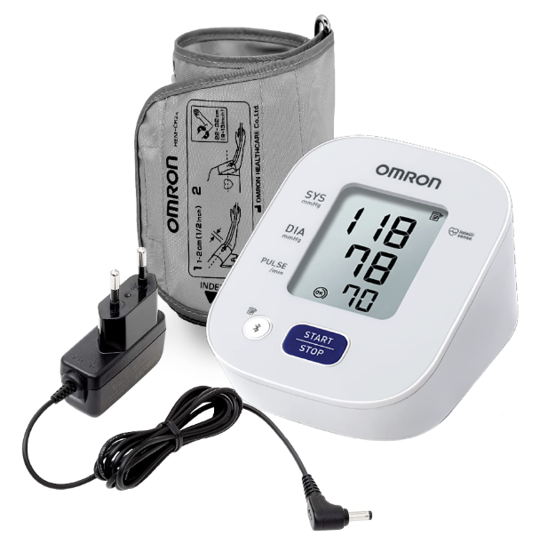
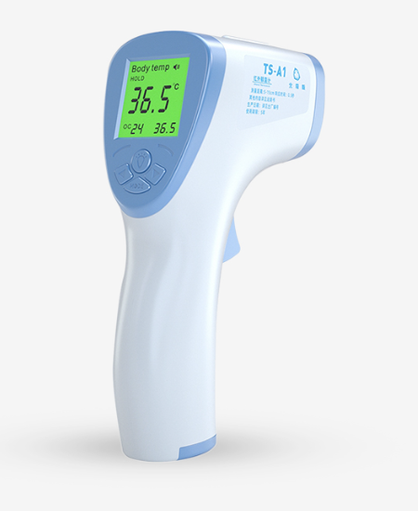
Recommendations
Call for further studies
Call for multi-disciplinary approach
Address bottlenecks in QoC
GAIN support with equipment
Introduced equipment signing sheet
Will re-evaluate
Strengths
Longitudinal cohort
Limitations
Not known whether documentation reflects actual care provided

Slide 15
Thank you!
Nelson Mwale
nelsonmwale@gaiamalawi.org

