Slide 1
Assessing Barriers of Contraceptive Uptake Among Adolescent Girls in a Rural District in Malawi
Sitalire Kapira (1,2), Hannah Gilbert (2), Emilia Connolly (1), Joan Kaufman(2), Isaac Mphande (1), Chiyembekezo Kachimanga (1), Anatole Manzi (1,2) and Emily Wroe (2)
1-Partners in Health, 2-Harvard University
Date: 10 March 2024

Slide 2
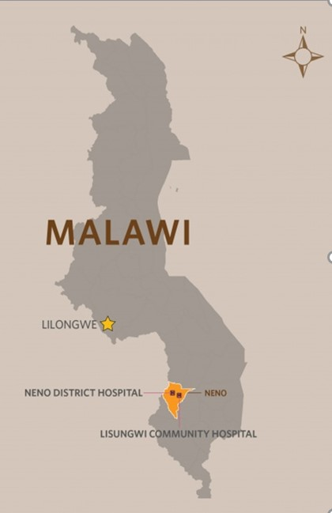
Background
The total fertility rate is 5.3 births per woman in Neno and 4.4 births per woman in Malawi as a country (DHS, 2016)
Malawi has among the highest rates of adolescent pregnancy worldwide with 29% of adolescent girls having had at least one live birth before 18 years old (Chirwa, 2019)
Malawi has the highest rate of adolescent pregnancy in Southern Africa at 29% with Kenya at 18% (Wado, 2019)
APZU Communication Orientation

Slide 3
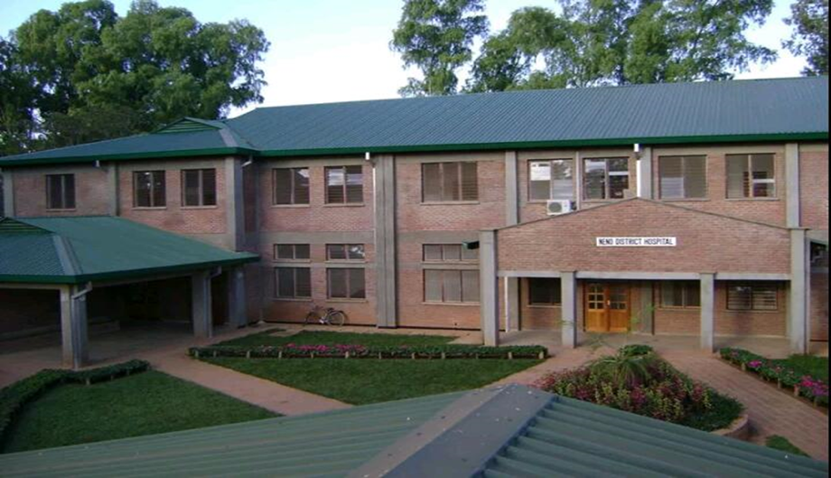
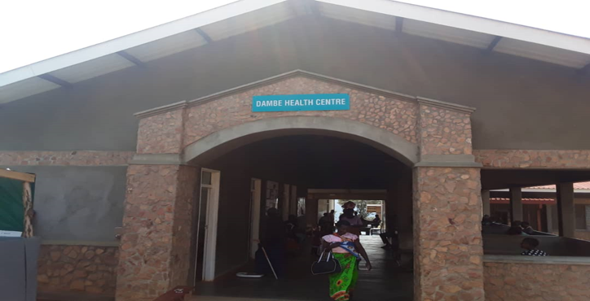
Aim
Goal: To identify barriers to contraceptive uptake by adolescent girls in Neno, Malawi.
Location: Neno District, Malawi
Timespan: June 2020 to Nov 2020
APZU Communication Orientation

Slide 4
Explanatory sequential mixed methods study Design
DHIS2 data (11 facilities)
mHealth data (2 facilities)
Survey (6 facilities)
Prevalence of contraceptive uptake
Quality of care
Descriptive statistics, summary tables, graphs
Quantitative data collection and analysis
Adaptation of the qualitative data collection tools
In-depth interviews (n=32)
Focus Group Discussion (n=30)
Qualitative data collection and analysis
Exploration of perception
Code and themes
Interpretation of results
APZU Communication Orientation

Slide 5
Quantitative results
APZU Communication Orientation

Slide 6
Quantitative results
APZU Communication Orientation

Slide 7
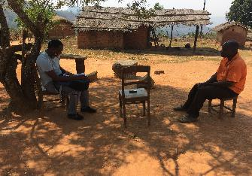
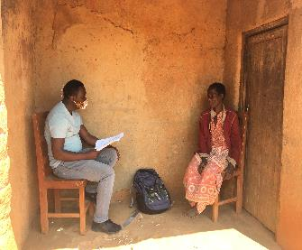
Qualitative results
Four thematic categories
1. Sources of information and support for adolescent sexual health:
Traditional forms of community-based teachings have dissolved.
Media Consumption
2. Paths of possibilities available to girls in the community
Need for professional (real) role models
Poverty as a driver for early marriage
The perceived link between early contraceptive use and barrenness
3. Provision of services that meet adolescent needs
Lack of private space
Attitude of healthcare workers toward adolescents
Lack of adolescent-friendly services
4. Impact of COVID-19
APZU Communication Orientation

Slide 8
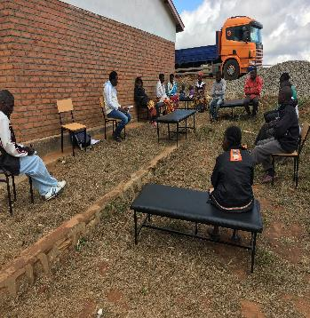
Quotes
“They watch everything concerning pornography which has made their minds corrupt…..with time, due to exposure to these things, boys will take advantage of a girl child by watching these things to develop feelings which in the end make them experiment on sex.” -Female parent, Neno
“Grown-up men have the lifestyle of having sex with teenage girls, and they take advantage of them because of poverty and in the end being used by such men.”- Local leader, Neno
APZU Communication Orientation

Slide 9
Mixed methods results
At all facilities, no clinician offered health talks
Dissolution of traditional forms of health counseling, link between contraceptive use and barrenness
Main barriers
The uptake of contraceptives is 20% higher in urban than rural areas
Widespread poverty in rural areas is a driver for early marriage
Misconceptions and misinformation
20% reduction in contraceptive uptake in 2020
Parents noted increased pregnancies due to lockdown
Poverty
Adolescent suffering
Impact of COVID-19
Lack of access to quality contraceptive care
70% of the facilities offer contraceptives once per week and are offered by a single nurse
Lack of time and facility space to provide adequate, appropriate counseling to adolescents reporting to the clinic
APZU Communication Orientation

Slide 10
Discussion
Need for health systems strengthening to offer acceptable FP screening, counseling, and methods to youth
Incorporation of long-term methods had a high acceptance rate of contraceptives among adolescents in the US (Kavanaugh, 2013)
2. Poverty
Poverty is a pervasive driver that underpins many of these factors and directly results in short-lived, early marriages between young girls and older men
In Bangladesh, even married adolescent girls could not make their own decisions regarding contraceptive services, these could include father-in-laws who were supporting them financially (Shahabuddin, 2016)
APZU Communication Orientation

Slide 11
Conclusions and Recommendations
Barriers to adolescent contraceptive uptake are multi-sectoral and inadequately addressed by existing programs in Malawi.
Increase efforts to provide effective and culturally acceptable interventions to increase adolescent contraceptive uptake.
Malawi’s government needs to put much effort into moving from having an excellent policy on youth-friendly health services theoretically to having it in actual practice.
APZU Communication Orientation

Slide 12
Acknowledgements
This work was conducted with support from the Master of Medical Sciences in Global Health Delivery program of Harvard Medical School Department of Global Health and Social Medicine and financial contributions from Harvard University and the Ronda Stryker and William Johnston MMSc Fellowship in Global Health Delivery. The content is solely the responsibility of the authors and does not necessarily represent the official views of Harvard University and its affiliated academic health care centers.
Special thank you to the former Departmental Chair, the late Dr. Paul Farmer, Program Director Dr. Joia Mukherjee, my primary mentor Dr. Emily Wroe and the research committee: Dr. Anatole Manzi, Dr. Emilia Connolly, Dr. Hannah Gilbert, Dr. Joan Kaufman and all faculty members at Department of Global Health and Social Medicine.
My gratitude goes to Basimenye Nhlema and the entire leadership (both past and present) of Abwenzi Pa Za Umoyo/Partners in Health (APZU/PIH), Kim and Global Action in Nursing (GAIN), and the Malawi Ministry of Health, particularly for allowing the research to take place and supporting the field implementation.
APZU Communication Orientation

Slide 13
The End!
APZU Communication Orientation

