Slide 1
The power of mentorship
The Impact of longitudinal Midwife mentorship on availability of essential drugs and supplies in five primary health facilities in Blantyre district, Malawi
Oveka Jana
Abstract # IMNHC188
Notes:
General tips
Avoid flashy transitions, elaborate animations or sound effects: they can be distracting, and they also add to your file size so that your presentation might be difficult to load.
Simplicity: simple, consistent slide layouts work best in ensuring your audience can follow along.
Slide backgrounds should be subtle so that your content stand out.
Leave some empty space: clutter reduces readability. Leave breathing room around text and image, so that they are easily distinguishable at a distance.
Standardize position, colors, and styles.
Font and text styles
Use a standard font that comes with the PowerPoint package to ensure your formatting will stay the same on different computers.
Please use Calibri font.
Use bold and large font for headlines. Avoid all caps.
Font size should be no smaller than 24pt; to test readability, stand back 2m from the monitor to see if you can still read the slides.
All headlines should be the same font, and all body text should be the same font, so that the audience knows what to expect.
Limit content to around 6 bullet points per slide. Use short sentences.
Use a single style of bullets throughout the presentation.
Colors
Color of text should clearly stand out from the background.
Consider the accessibility of different colors; some vibrant colors can be difficult to see on screen, especially for people with color-blindness. Some color combinations to avoid include:
Red and green
Green and brown
Blue and purple
Green and black
Avoid using too many colors in one chart. Use different shades of colors can help if you have many datapoints to represent.
Imagery
Use high quality images.
Use one or two large images per slide, instead of many small images that are hard to see from a distance.
Arrange images on a grid.
Callouts
Consider building callouts (arrows and circles) in your presentation to highlight important details.
Limit content to around 6 bullet points per slide. Use short sentences and use a single style of bullets throughout the presentation.

Slide 2
Conflict of interest disclosure
We have no conflict of interests to declare

Slide 3
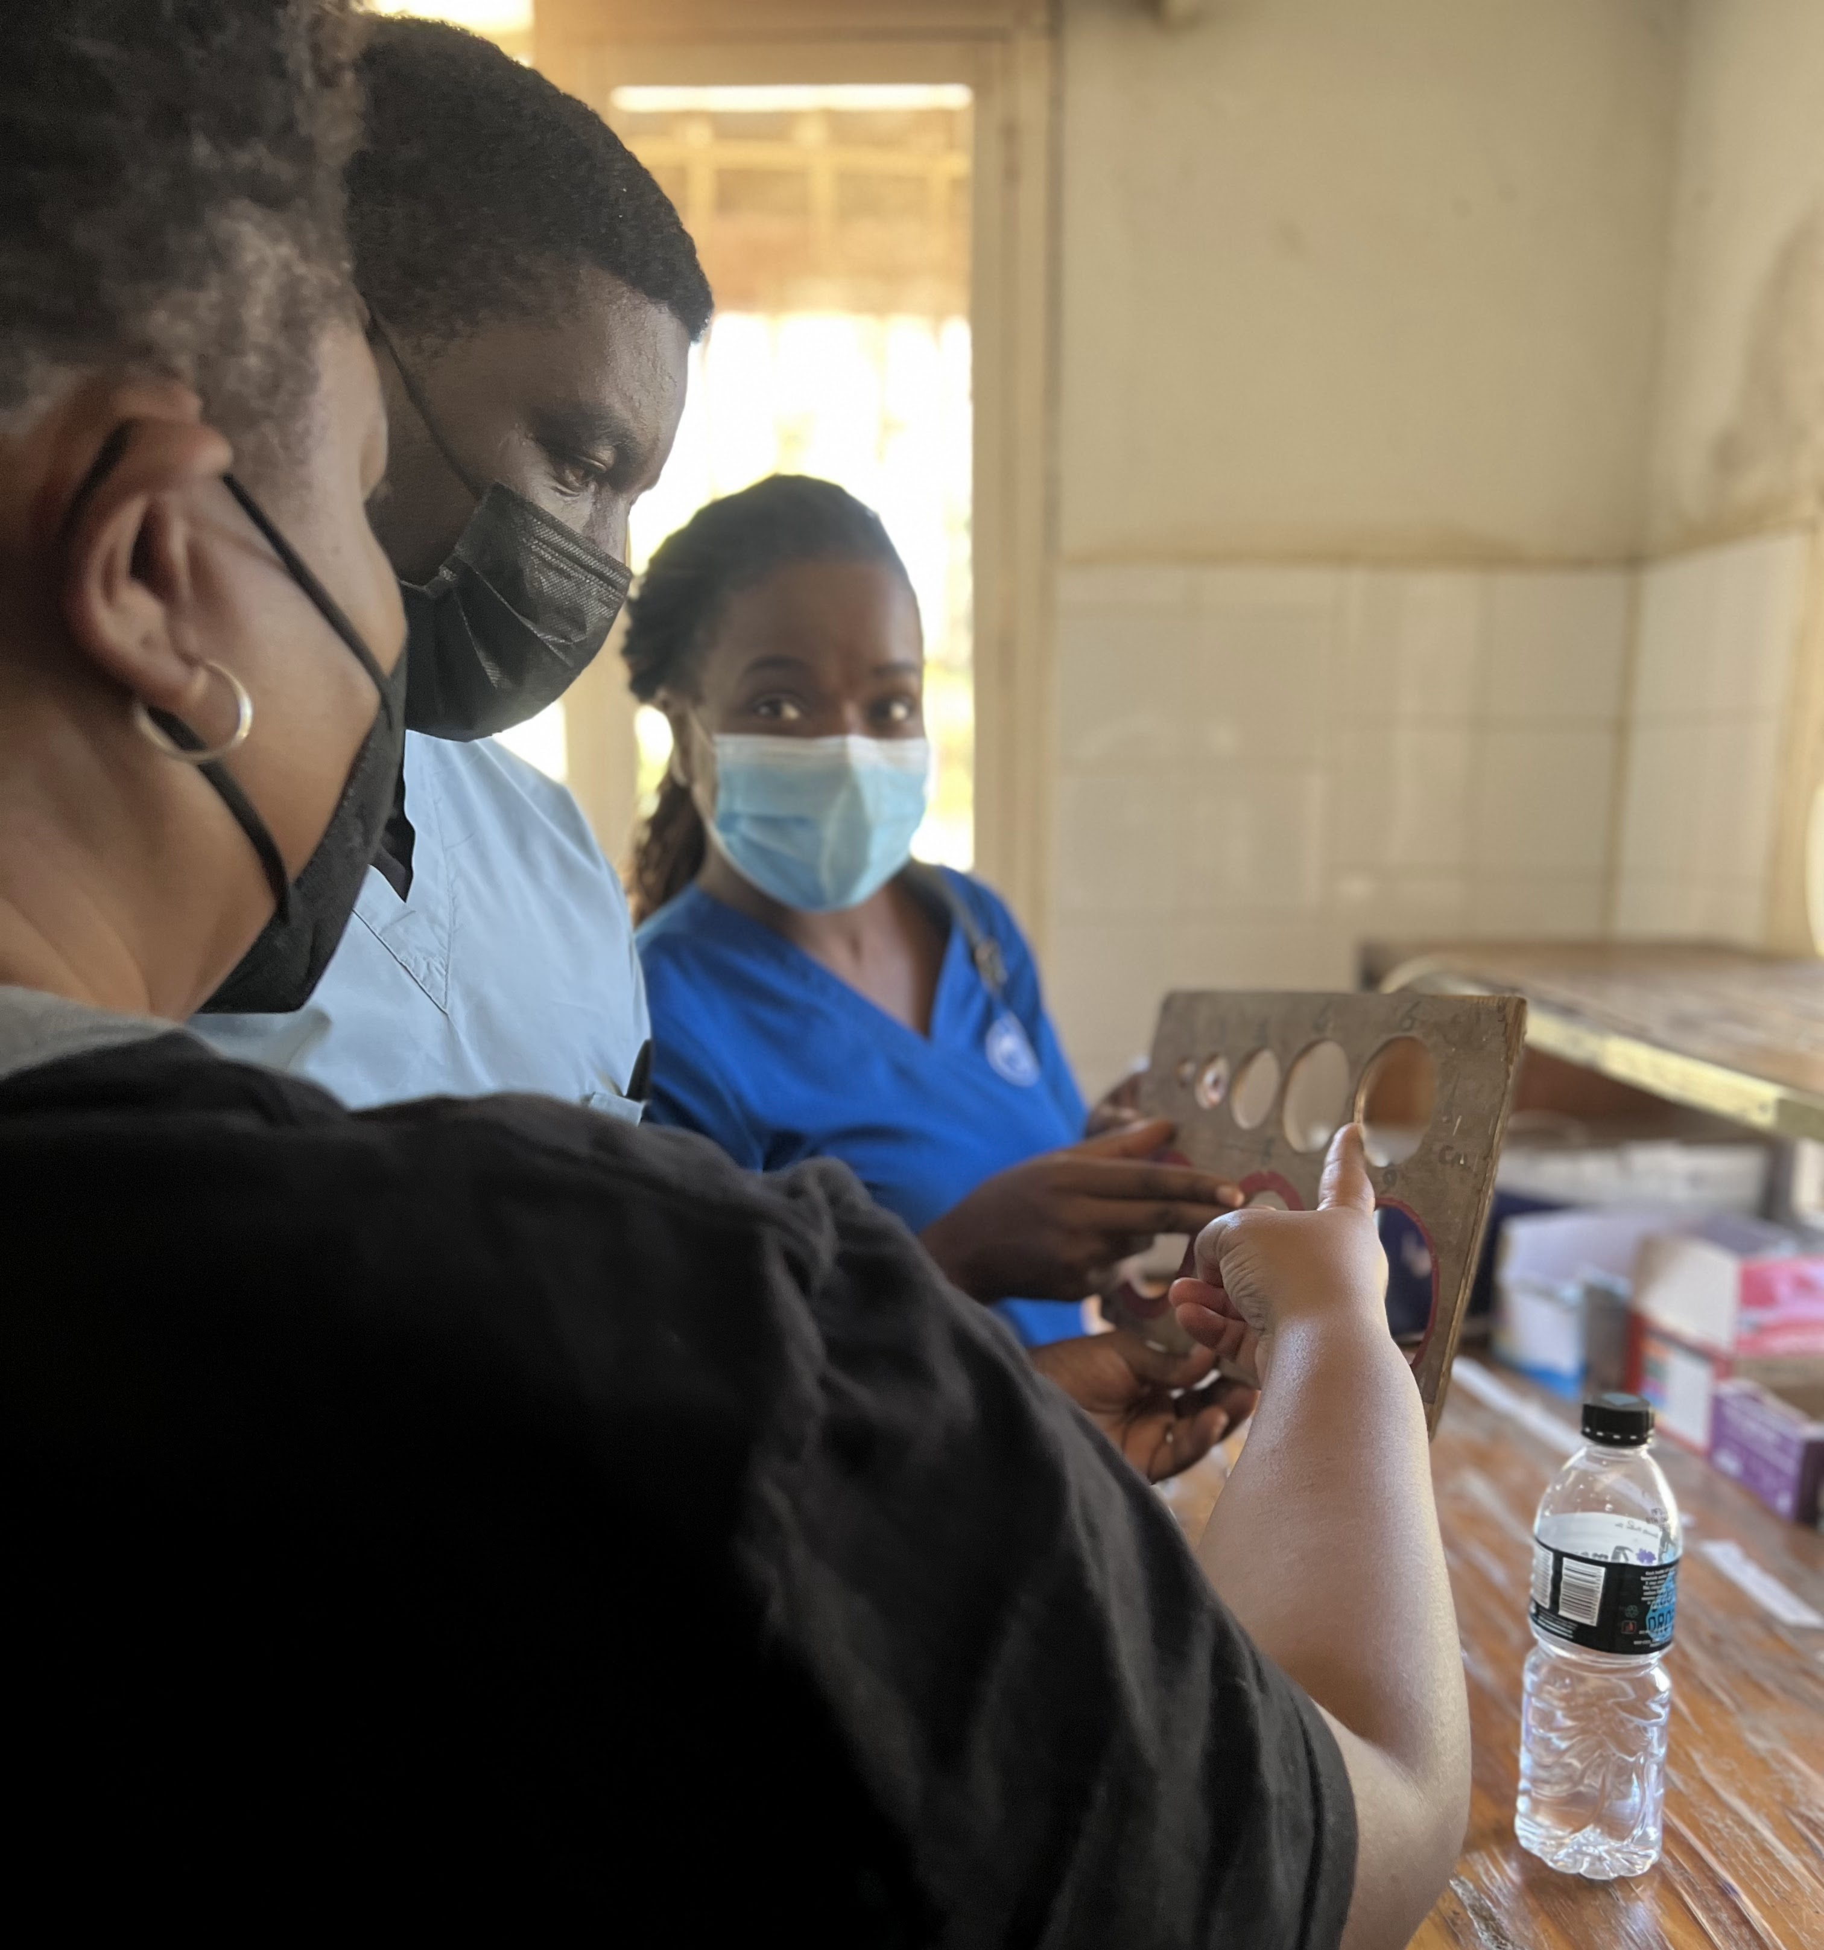
Background
Nurses and midwives form the backbone of maternal and newborn health care delivery in Malawi.
The University of California San Francisco Global Action in Nursing (GAIN) project aims to improve maternal and newborn health by supporting nurses and midwives with intensive training and longitudinal bedside mentorship.
The project includes monitoring the availability of essential drugs and supplies.

Slide 4
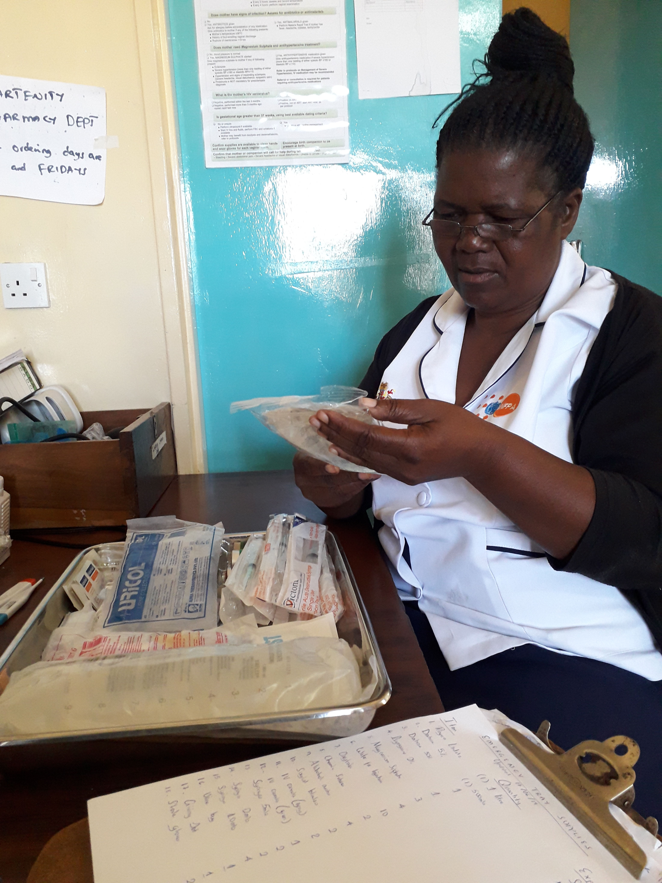
Methods
Data on the availability of 13 locally-prioritized essential drugs and supplies was collected on a bi-weekly basis from five public health facilities via CommCare between 2019 and 2022.
Analyses looked at overall availability, changes over time, facility-level trends, and was compared to qualitative information such as district-level stockouts and other influencing factors.

Slide 5
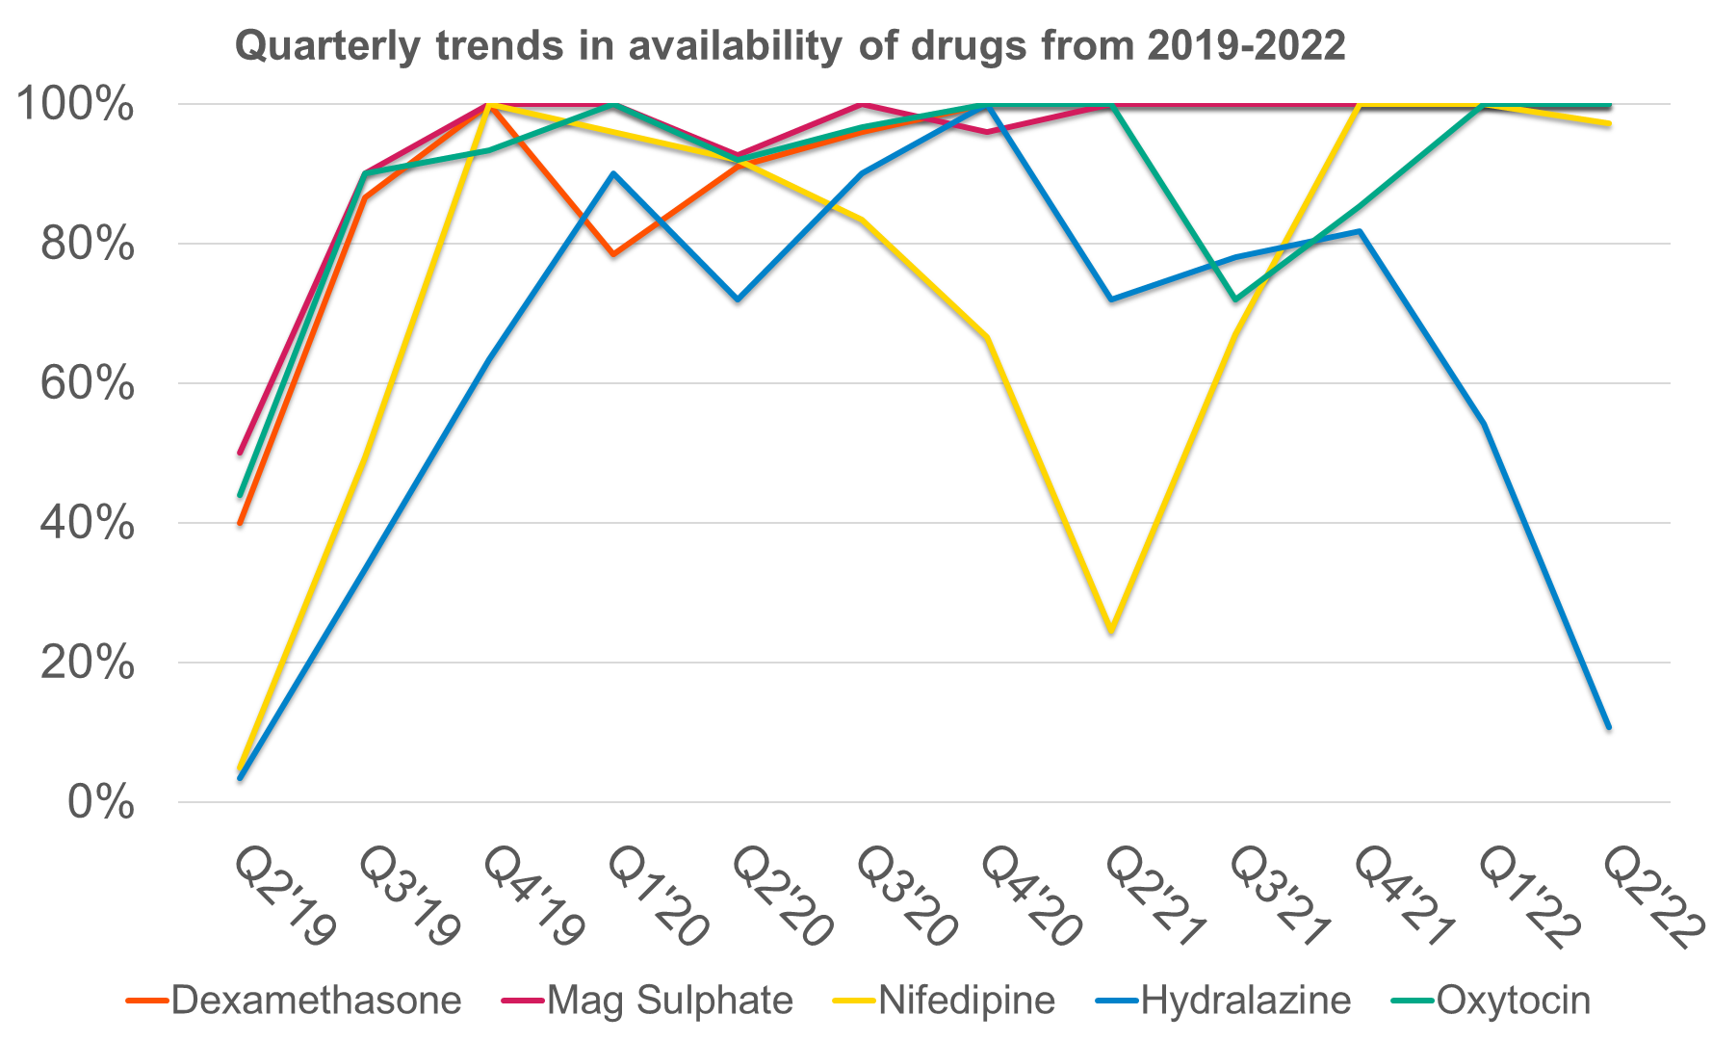
Results
All facilities showed immediate and significant improvement in availability of the 13 essential drugs and supplies from an average of 38% at the start (range: 5%-50%) to 95% by the third quarter (range: 80%-100%) of initiating the GAIN mentorship.
Over time there was a decrease in variability of resources across all facilities. Compared to drugs, supplies showed the most variability and were more difficult and costly to replace, e.g. autoclaves and anti-shock garments.

Slide 6
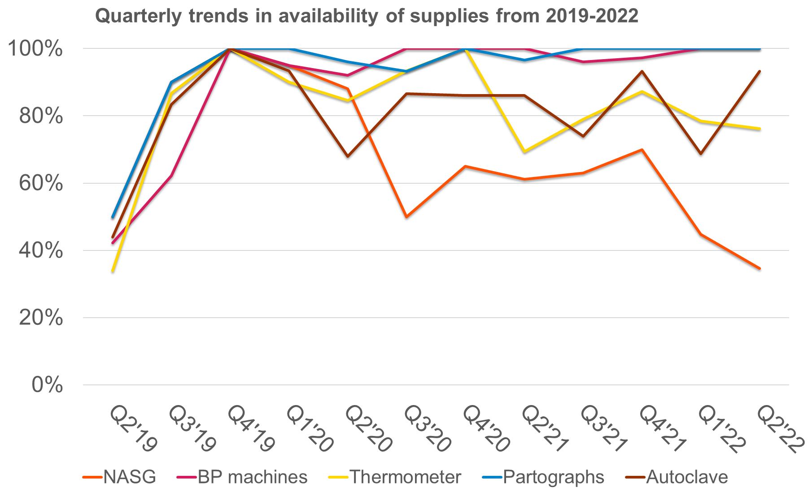
Results
Additionally, anti-shock garments were less available after the intervention due to uptake in use.
The facility with the lowest patient volume had consistently higher availability of drugs and supplies across all quarters (average 81%), while the two facilities with highest patient volume were more sporadic, 56% and 47%, respectively.

Slide 7
Conclusion
Equipping nurses and midwives with critical skills to monitor and advocate for essential drugs and supplies led to more consistent availability.
Despite procurement limitations, frontline providers can recognize need and advocate for the availability of essential resources.
Equipping nurses and midwives with the skills and confidence to care for their patients is critical to enhancing health care delivery and subsequently improving patient outcomes

Slide 8
Recommendations for the field
Interventions to improve the quality of maternal and newborn care should largely involve Nurses and Midwives.
Longitudinal bedside mentorship can and should be integrated into in-service training for health providers across the country.
Procurement policies should provide greater leeway for independent sourcing of essential drugs and supplies at district level to prevent long-term stockouts.

Slide 9
Thank you!
The GAIN project is funded by the generous donation from the Wyss Medical Foundation

