Slide 1
Reducing intrapartum stillbirths among pregnant women in southeastern Liberia A nursing and midwifery-led quality improvement initiative Presented by: Daniel Maweu & Garmai Forkpah
Contributors:
Yassah V. Moluwei, Sonnie Kollie, Marshall Sackey, Merab Nyishime, Dr. Ibrahim Sanoe, Dr. George Methodius, Nastassia Donoho, Dr. Anatole Manzi, Dr. Sterman Toussaint, Viola Karanja, Dr. Sarah Anyango, Dr. Maxo Luma
Notes:
General tips
Avoid flashy transitions, elaborate animations or sound effects: they can be distracting, and they also add to your file size so that your presentation might be difficult to load.
Simplicity: simple, consistent slide layouts work best in ensuring your audience can follow along.
Slide backgrounds should be subtle so that your content stand out.
Leave some empty space: clutter reduces readability. Leave breathing room around text and image, so that they are easily distinguishable at a distance.
Standardize position, colors, and styles.
Font and text styles
Use a standard font that comes with the PowerPoint package to ensure your formatting will stay the same on different computers.
Please use Calibri font.
Use bold and large font for headlines. Avoid all caps.
Font size should be no smaller than 24pt; to test readability, stand back 2m from the monitor to see if you can still read the slides.
All headlines should be the same font, and all body text should be the same font, so that the audience knows what to expect.
Limit content to around 6 bullet points per slide. Use short sentences.
Use a single style of bullets throughout the presentation.
Colors
Color of text should clearly stand out from the background.
Consider the accessibility of different colors; some vibrant colors can be difficult to see on screen, especially for people with color-blindness. Some color combinations to avoid include:
Red and green
Green and brown
Blue and purple
Green and black
Avoid using too many colors in one chart. Use different shades of colors can help if you have many datapoints to represent.
Imagery
Use high quality images.
Use one or two large images per slide, instead of many small images that are hard to see from a distance.
Arrange images on a grid.
Callouts
Consider building callouts (arrows and circles) in your presentation to highlight important details.
Limit content to around 6 bullet points per slide. Use short sentences and use a single style of bullets throughout the presentation.

Slide 2
Conflict of interest
We confirm we have no conflicts of interest to disclose.

Slide 3
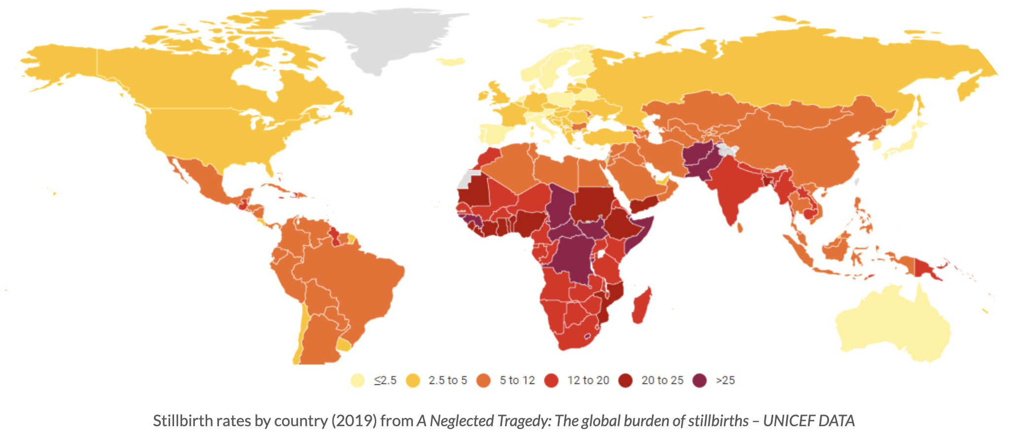
Global stillbirth rates
Of the 2.6 million stillbirths globally, 98% occur in low- and middle-income countries
Liberia is among countries with some of the highest stillbirth rates
Fresh stillbirths (FSBs) make up nearly 50% of all stillbirths
Majority of FSBs are preventable
Notes:
In your presentation [while talking], make the distinction between macerated and fresh stillbirth

Slide 4
FSBs in southeastern Liberia
In 2019, J.J. Dossen Memorial Hospital (JJD) in Liberia reported 46 FSB per 1000 births
Target rate: 12/1000 births or less by 2030
Nurses and midwives led a quality improvement (QI) project aimed to reduce FSB rates by 56.5%
Goal: 46/1000 births in 2019 to 20/1000 births in 2021

Slide 5
Methods
Baseline survey of midwifery practices was conducted in 2019
Fishbone analysis was used to identify key causes of FSB
The first Plan-Do-Study-Act (PDSA) cycle ran between January 2020 to December 2021
Direct observation and chart reviews were used to collect post-intervention data
Stillbirth audits were done for all cases to identify contributing factors
Notes:
Baseline survey of midwifery practices was conducted in 2019 prior to the start of the project
Updated admission, management of labor, and handover policies were updated for obstetric patient care

Slide 6
Causes of high FSB rates at JJD
The baseline survey found main causes of FSB:
Poor shift handover
Delays in partograph documentation
Challenges calling physicians during emergencies
Pre-intervention:
Bedside handover of fetal heart tones during midwife shift turnover was 0%
Timely and consistent use of partograph was 75%
Average physician emergency response time was 30 minutes

Slide 7
The intervention
Intervention:
Basic Emergency Obstetric and Newborn Care (bEmONC) training
Longitudinal clinical mentorship
Update admission, labor management, and shift handover policies
Reinforced team work & communication between the physician and the midwives
Notes:
we consistently continued reinforced team work between the Physician and the midwives and putting in measure such as proper documentation in regards to time whenever a physician is called for any Non-reassuring fetal status case by midwives led to a drop in the Physician emergency response time a 10 minutes.

Slide 8
Post-QI intervention Results
FSB dropped by 60.9% to 18/1000 births in 2021 compared to 46/1000 births in 2019
Timely partograph use increased to 100%
Fetal heart tone assessment during shift turnover improved by 92%
Average physician emergency response time dropped to 10 minutes

Slide 9
Post-QI intervention Results
Longitudinal mentorship

Slide 10
Lessons learnt
Most causes of FSB are related to gaps in timely diagnosis and intervention by providers
Proper monitoring of labor, timely emergency response, and bedside assessment of fetal heart tones during shift turnover are key for reducing FSB
Team work between the physician and the midwives is vital in improving maternal & neonatal outcomes
Training and mentorship in bEmONC and CEmONC are necessary for obstetric providers

Slide 11
Conclusion
Skilled midwives must be at the center of interventions for reducing FSBs
Nurse & Midwives are the leaders of maternity care in Liberia
With their dedicated focus, we envision that Liberia can reduce stillbirth to 12/1000 births or less by 2030

Slide 12
Increasing midwifery led interventions by 95% would avert 65% of still births (ICM, 2021)

Slide 13
Thank you!
We acknowledge the tireless support & dedication of all midwives, doctors and staff of JJ Dossen Memorial Hospital and Maryland County Health team, Liberia towards this QI project. We also acknowledge the support from Partners In Health, UCSF – Global Action In Nursing & Ministry of Health, Liberia

Slide 14
Sources
Horton R, Samarasekera U. Stillbirths: Ending an epidemic of grief. Lancet. 2016;387(10018):515-516. doi:10.1016/S0140-6736(15)01276-3
https://www.alignmnh.org/stillbirth-evidence/
WHO. Stillbirth: Overview. Accessed August 19, 2022. https://www.who.int/health-topics/stillbirth#tab=tab_1
The Lancet. Ending Preventable Stillbirths An Executive Summary for The Lancet’s Series.; 2016. Accessed May 20, 2021. https://www.thelancet.com/pb/assets/raw/Lancet/stories/series/stillbirths2016-exec-summ.pdf
Lawn JE, Blencowe H, Waiswa P, et al. Stillbirths: rates, risk factors, and acceleration towards 2030. Lancet. 2016;387(10018):587-603. doi:10.1016/S0140-6736(15)00837-5
Blencowe H, Cousens S, Jassir FB, et al. National, regional, and worldwide estimates of stillbirth rates in 2015, with trends from 2000: a systematic analysis. Lancet Glob Heal. 2016;4(2):e98-e108. doi:10.1016/S2214-109X(15)00275-2
Ministry of Health, Republic of Liberia. DHIS 2. Published online 2022.
ICM. (2021b). International day of the midwives: advocacy toolkit and resource pack. https://www.internationalmidwives.org/assets/files/event-files/2021/04/11009-idm-toolkit-1.pdf

